Slide 1
面向中小学科学教育大模型的领域知识增强方法研究与实现
汇报人：时子延
指导教师：周俊生老师
成员：董文杰 马艺轩
2024.12.19
Notes:
Good afternoon ladies and gentlemen. It's a pleasure to be here with you today. My talk today will deal primarily with Adaptive Long-Short Pattern Transformer for Stock Investment Selection.

Slide 2
研究计划与进展情况
01
阶段性成果
02
目录
中期成果总结
03
04
下阶段计划
03
05
04
05
Notes:
First of all, I'll be presenting the background of Stock Investment Selection. Then, I'll introduce our methods and experiments. Finally, I'll make a conclusion of the work.

Slide 3
进展情况
前期工作
课题调研，信息检索
参与K12数据集构建
相关技术栈学习
最小可用产品实现（MVP）
知识图谱构建
现阶段成果
知识图谱构建与完善
改进Naïve RAG的框架与信息检索
构建K12领域的基准测试
前端优化，交互优化
研究与创新
PDFdata to KG 自动化脚本
原始检索增强生成框架（Naïve RAG）的优化
以知识图谱子图为检索单位进行快速信息检索
构建基准测试评估模型
Advanced RAG
Faiss on KG Subgraphs
TechEdu KG & Benchmark
Notes:
Now let’s turn to the first part of my talk, background. Different from the general time series modeling, it is difficult to assess stock’s evolving trend confronting with highly volatile and interrelated natures of the market. Also, the synergy [ˈsɪnədʒi] effect is another prominent trait of stock market. This effect means that related stocks are apt to exhibit synchronous [ˈsɪŋkrənəs] changes. However, Previous works mostly treat individual stocks as isolated and some studies just resort to limited domain knowledge which may lead to information bias.

Slide 4
研究计划
应用场景
解答科学教育知识问题
为中小学科学教育的教学与学习提供智能、个性化支持
大模型缺陷
知识性幻觉
知识有限，新知识更新困难，大模型训练成本极高
利用训练好的大模型进行运算，输入新数据来生成输出结果的过程。
从大模型推理入手
使用检索增强生成框架
加强大模型在推理阶段对知识的利用
Notes:
Now let’s turn to the first part of my talk, background. Different from the general time series modeling, it is difficult to assess stock’s evolving trend confronting with highly volatile and interrelated natures of the market. Also, the synergy [ˈsɪnədʒi] effect is another prominent trait of stock market. This effect means that related stocks are apt to exhibit synchronous [ˈsɪŋkrənəs] changes. However, Previous works mostly treat individual stocks as isolated and some studies just resort to limited domain knowledge which may lead to information bias.

Slide 5
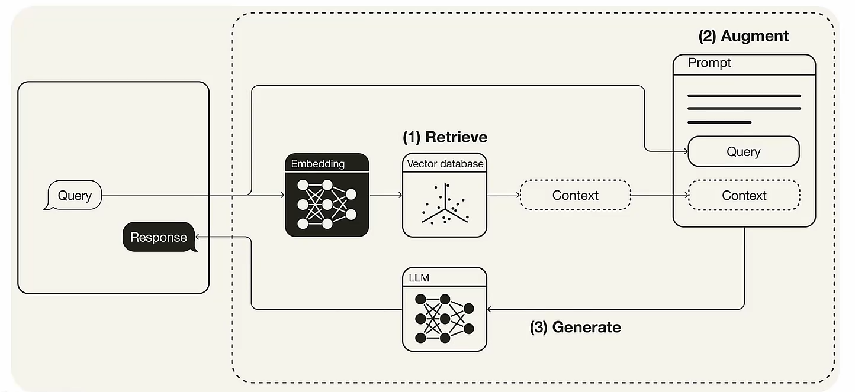
研究计划
知识性幻觉
答案透明度
检索增强生成框架（RAG）
知识有限且更新困难
更新外部数据库
知识图谱
无需进行如消除歧义和冗余等操作的预处理，提高检索准确率
三元组结构化数据
Notes:
Now let’s turn to the first part of my talk, background. Different from the general time series modeling, it is difficult to assess stock’s evolving trend confronting with highly volatile and interrelated natures of the market. Also, the synergy [ˈsɪnədʒi] effect is another prominent trait of stock market. This effect means that related stocks are apt to exhibit synchronous [ˈsɪŋkrənəs] changes. However, Previous works mostly treat individual stocks as isolated and some studies just resort to limited domain knowledge which may lead to information bias.

Slide 6
阶段性成果—KG构建
知识图谱构建与可溯化
课本PDF数据
将课本PDF数据转化为markdown文本
NLP data
Model-based Sentence Segmentation（Bert）
将中文翻译为英文以提高IE准确度
知识图谱三元组
基于 BERT 模型实现三元组的自动生成
增加一维标识（如句子ID）保证生成的边集可溯性
Notes:
Now let’s turn to the first part of my talk, background. Different from the general time series modeling, it is difficult to assess stock’s evolving trend confronting with highly volatile and interrelated natures of the market. Also, the synergy [ˈsɪnədʒi] effect is another prominent trait of stock market. This effect means that related stocks are apt to exhibit synchronous [ˈsɪŋkrənəs] changes. However, Previous works mostly treat individual stocks as isolated and some studies just resort to limited domain knowledge which may lead to information bias.

Slide 7
阶段性成果—KG构建
知识图谱可视化
Notes:
Now let’s turn to the first part of my talk, background. Different from the general time series modeling, it is difficult to assess stock’s evolving trend confronting with highly volatile and interrelated natures of the market. Also, the synergy [ˈsɪnədʒi] effect is another prominent trait of stock market. This effect means that related stocks are apt to exhibit synchronous [ˈsɪŋkrənəs] changes. However, Previous works mostly treat individual stocks as isolated and some studies just resort to limited domain knowledge which may lead to information bias.

Slide 8
阶段性成果—KG构建
知识图谱数据库搭建
Notes:
Now let’s turn to the first part of my talk, background. Different from the general time series modeling, it is difficult to assess stock’s evolving trend confronting with highly volatile and interrelated natures of the market. Also, the synergy [ˈsɪnədʒi] effect is another prominent trait of stock market. This effect means that related stocks are apt to exhibit synchronous [ˈsɪŋkrənəs] changes. However, Previous works mostly treat individual stocks as isolated and some studies just resort to limited domain knowledge which may lead to information bias.

Slide 9
阶段性成果--Advanced RAG
Advanced RAG
原始检索增强生成框架（Naïve RAG）不足以应对复杂提问
复杂提问一般具有历史连续，内容冗余等特点，容易导致LLM产生知识性幻觉。
通过重写用户请求模块，增加内容提取模块，事实验证模块实现原始检索增强生成框架的优化—Advanced RAG
Notes:
Now let’s turn to the first part of my talk, background. Different from the general time series modeling, it is difficult to assess stock’s evolving trend confronting with highly volatile and interrelated natures of the market. Also, the synergy [ˈsɪnədʒi] effect is another prominent trait of stock market. This effect means that related stocks are apt to exhibit synchronous [ˈsɪŋkrənəs] changes. However, Previous works mostly treat individual stocks as isolated and some studies just resort to limited domain knowledge which may lead to information bias.

Slide 10
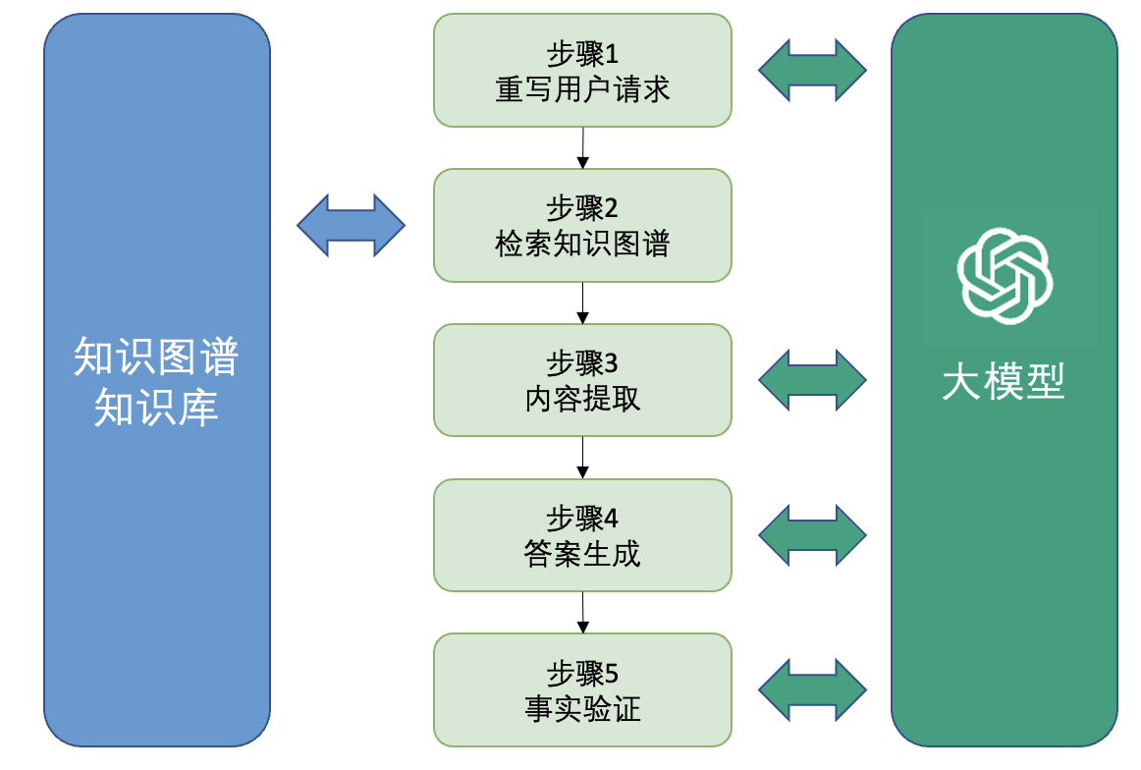
阶段性成果--Advanced RAG
Advanced RAG
Notes:
However, directly applying Transformer to modeling stock movements is problematic in two aspects. Firstly, the global self-attention focuses on point-wise token similarities without contextual insights. So the lack of pattern-wise interaction hinders the adequate discrimination of stock tendency and is susceptible to noise points. Secondly, the basic query-key matching paradigm is position agnostic. For example, in this figure, {A;B} reflects stock wave patterns in the context of long-term spans and {C;D} reflects short-term spans. The patterns C and D are closer than A and B, which means that their interaction is more responsible for observing high-frequency regularities. This inspires us to factor in the elapsed time between stock change patterns.

Slide 11
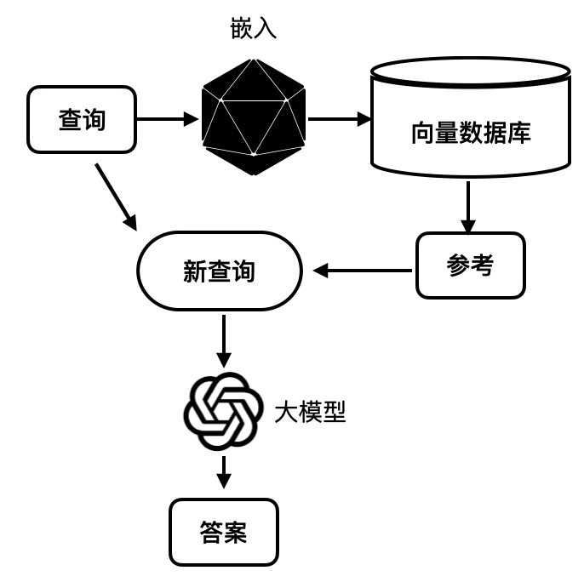
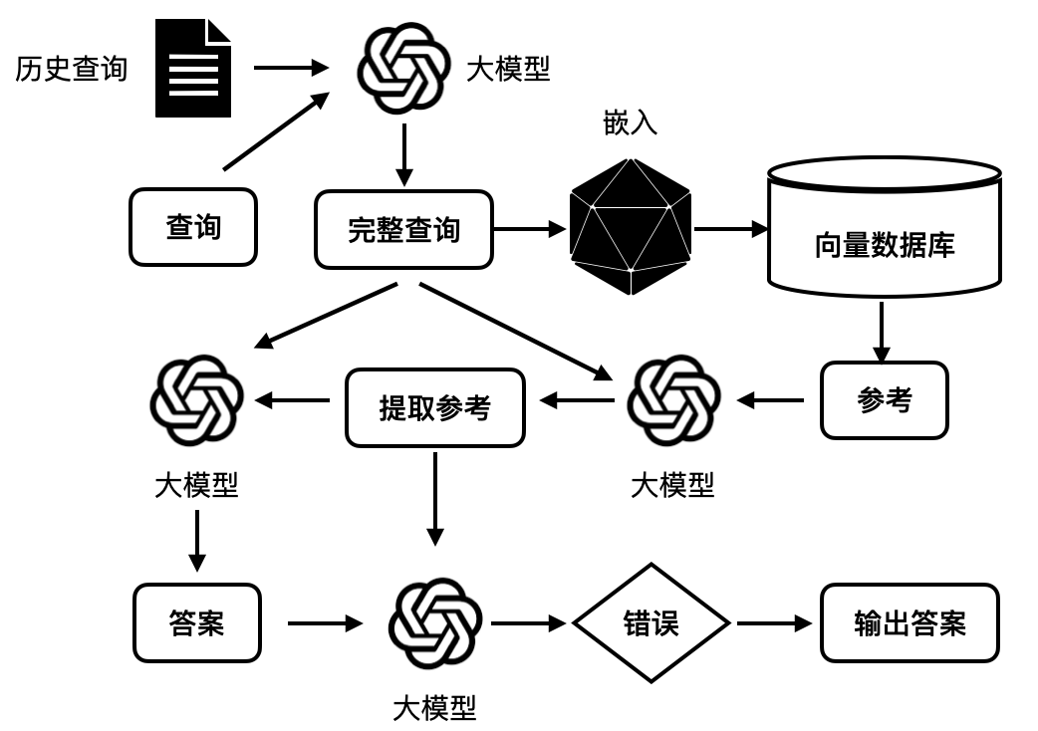
阶段性成果--Advanced RAG
流程对比
Naïve RAG
Advanced RAG
Notes:
However, directly applying Transformer to modeling stock movements is problematic in two aspects. Firstly, the global self-attention focuses on point-wise token similarities without contextual insights. So the lack of pattern-wise interaction hinders the adequate discrimination of stock tendency and is susceptible to noise points. Secondly, the basic query-key matching paradigm is position agnostic. For example, in this figure, {A;B} reflects stock wave patterns in the context of long-term spans and {C;D} reflects short-term spans. The patterns C and D are closer than A and B, which means that their interaction is more responsible for observing high-frequency regularities. This inspires us to factor in the elapsed time between stock change patterns.

Slide 12
阶段性成果--Advanced RAG
用户请求模块
重写原因：
提问是连续的，用户的当前提问并不一定完整，而是包含着潜在的上文寓意。
构造了合理的prompt，将历史提问与当前提问共同输入进大模型中，得到重写后的用户请求。
表1 重写输入输出结果
输入 | 输出
history：介绍一下光的折射 request：那光的反射呢？ | 介绍一下光的反射
Notes:
However, directly applying Transformer to modeling stock movements is problematic in two aspects. Firstly, the global self-attention focuses on point-wise token similarities without contextual insights. So the lack of pattern-wise interaction hinders the adequate discrimination of stock tendency and is susceptible to noise points. Secondly, the basic query-key matching paradigm is position agnostic. For example, in this figure, {A;B} reflects stock wave patterns in the context of long-term spans and {C;D} reflects short-term spans. The patterns C and D are closer than A and B, which means that their interaction is more responsible for observing high-frequency regularities. This inspires us to factor in the elapsed time between stock change patterns.

Slide 13
阶段性成果--Advanced RAG
内容提取模块
原因：
检索结果可能包含与用户查询无关的内容，对大模型造成干扰
大模型的输入长度限制
直接截断文档可能会丢失信息
构造滑动窗口检索内容提取器
检索结果：
['反丁烯二酸 中文名 反丁烯二酸', '反丁烯二酸 外文名 Fumaric acid', '反丁烯二酸 分子式 C4H4O4', '反丁烯二酸 分子量 116.07']
表2 背景内容提取的输入输出结果
输入 | 输出
request：介绍一下反丁烯二酸 | ['反丁烯二酸 中文名 反丁烯二酸', '反丁烯二酸 外文名 Fumaric acid', '反丁烯二酸 分子式 C4H4O4', '反丁烯二酸 分子量 116.07']
request：介绍一下乙烯 | No
Notes:
However, directly applying Transformer to modeling stock movements is problematic in two aspects. Firstly, the global self-attention focuses on point-wise token similarities without contextual insights. So the lack of pattern-wise interaction hinders the adequate discrimination of stock tendency and is susceptible to noise points. Secondly, the basic query-key matching paradigm is position agnostic. For example, in this figure, {A;B} reflects stock wave patterns in the context of long-term spans and {C;D} reflects short-term spans. The patterns C and D are closer than A and B, which means that their interaction is more responsible for observing high-frequency regularities. This inspires us to factor in the elapsed time between stock change patterns.

Slide 14
阶段性成果--Advanced RAG
答案生成模块
表3 答案生成的输入输出结果
输入 | 输出
content：['五氧化二磷 描述 五氧化二磷（phosphorus pentoxide），化学式P2O5。'] ['五氧化二磷 熔点 340℃' '五氧化二磷 沸点 360°C (升华)' ] request：五氧化二磷是什么？ | 五氧化二磷是一种无机化合物，化学式为P2O5，它的熔点时340℃，沸点是360℃。
Notes:
However, directly applying Transformer to modeling stock movements is problematic in two aspects. Firstly, the global self-attention focuses on point-wise token similarities without contextual insights. So the lack of pattern-wise interaction hinders the adequate discrimination of stock tendency and is susceptible to noise points. Secondly, the basic query-key matching paradigm is position agnostic. For example, in this figure, {A;B} reflects stock wave patterns in the context of long-term spans and {C;D} reflects short-term spans. The patterns C and D are closer than A and B, which means that their interaction is more responsible for observing high-frequency regularities. This inspires us to factor in the elapsed time between stock change patterns.

Slide 15
阶段性成果--Advanced RAG
事实验证模块
原因：
尽管提供了额外的背景知识来生成，但是大模型可能也会产生幻觉。
设计一个模块来进行进一步的事实验证
将参考背景文本和生成的答案提供给大模型进行判断是否包含事实错误。
背景文本：
1.光敏电阻 中文名 光敏电阻
2.光敏电阻 外文名 photoresistor"
3.光敏电阻 又称 光敏电阻器或光导管
4.光敏电阻 制作材料 硫化镉、硒、硫化铝、硫化铅和硫化铋
表4 事实验证的输入输出结果
输入 | 输出
answer：光敏电阻（photoresistor）是一种光敏元件，也称为光敏电阻器或光导管，常用的制作材料包括硫化镉、硒、硫化铝、硫化铅和硫化铋等材料。 | 否
answer：光敏电阻（photoresistor）是一种将检测到的气体的成分和浓度转换为电信号的传感器，它是利用某些半导体吸收某种气体后发生氧化还原反应制成的，主要成分是金属氧化物。 | 是
Notes:
However, directly applying Transformer to modeling stock movements is problematic in two aspects. Firstly, the global self-attention focuses on point-wise token similarities without contextual insights. So the lack of pattern-wise interaction hinders the adequate discrimination of stock tendency and is susceptible to noise points. Secondly, the basic query-key matching paradigm is position agnostic. For example, in this figure, {A;B} reflects stock wave patterns in the context of long-term spans and {C;D} reflects short-term spans. The patterns C and D are closer than A and B, which means that their interaction is more responsible for observing high-frequency regularities. This inspires us to factor in the elapsed time between stock change patterns.

Slide 16
阶段性成果
Advanced RAG
实现原始检索增强生成框架的优化 —— Advanced RAG
提出以知识图谱子图作为检索单位的检索方法 —— Faiss on KG Subgraphs
构建科学教育领域新的知识图谱以及基准测试 —— TechEdu KG & Benchmark
Advanced RAG框架
Notes:
In the early research on the Stock Investment Selection, the traditional machine learning methods use machine learning algorithms based on manual indicators. As a result, The hypothetical stochastic process may become stranded in catching non-stationary oscillations. In recent years, deep neural networks have shown encouraging prospects in characterizing stock dynamics, especially the RNNs are the dominant choice. However, they are ineffective to learn the dependencies of long-range discontinuous temporal states. As an alternative, the well-known Transformer can perform information exchange between input tokens to fix the deficiencies of RNN.

Slide 17
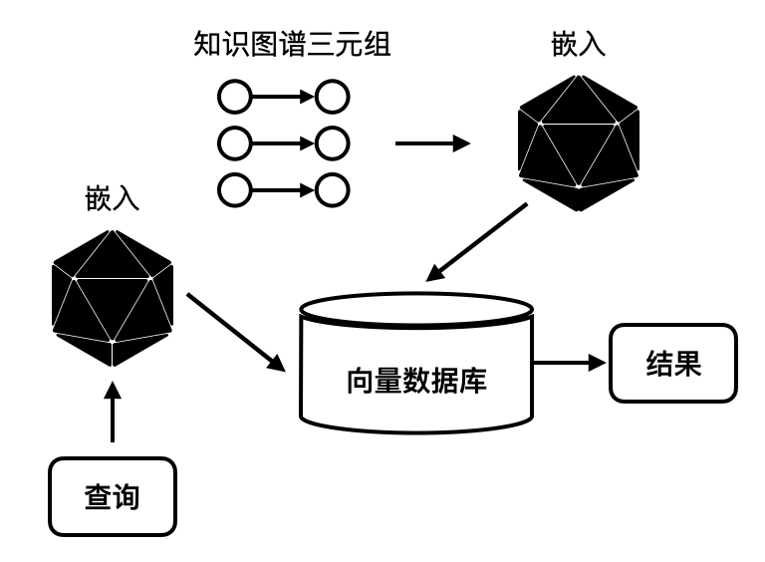
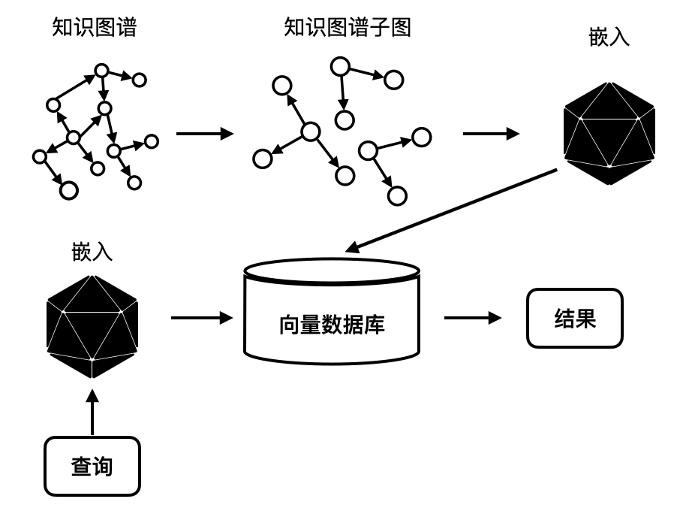
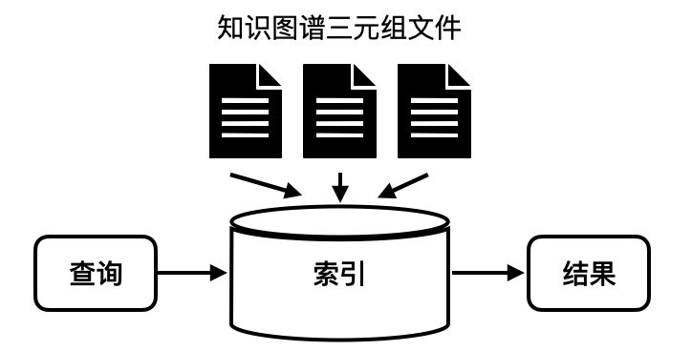
阶段性成果--Faiss on KG Subgraphs
以知识图谱子图作为检索单位的检索方法
Lucene on KG Triples
Faiss on KG Triples
Faiss on KG Subgraphs
Notes:
However, directly applying Transformer to modeling stock movements is problematic in two aspects. Firstly, the global self-attention focuses on point-wise token similarities without contextual insights. So the lack of pattern-wise interaction hinders the adequate discrimination of stock tendency and is susceptible to noise points. Secondly, the basic query-key matching paradigm is position agnostic. For example, in this figure, {A;B} reflects stock wave patterns in the context of long-term spans and {C;D} reflects short-term spans. The patterns C and D are closer than A and B, which means that their interaction is more responsible for observing high-frequency regularities. This inspires us to factor in the elapsed time between stock change patterns.

Slide 18
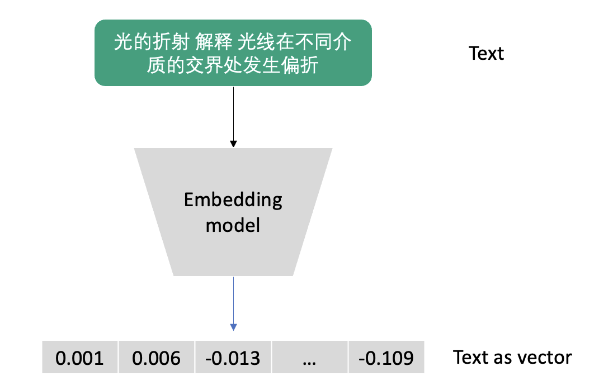
阶段性成果--Faiss on KG Subgraphs
具体步骤
1.将知识图谱三元组嵌入转为向量
2.进行基于DBSCAN算法的层次聚类知识图谱子图划分
3.基于知识图谱子图进行Faiss检索
Step1：Embedding
步骤一嵌入流程
Notes:
However, directly applying Transformer to modeling stock movements is problematic in two aspects. Firstly, the global self-attention focuses on point-wise token similarities without contextual insights. So the lack of pattern-wise interaction hinders the adequate discrimination of stock tendency and is susceptible to noise points. Secondly, the basic query-key matching paradigm is position agnostic. For example, in this figure, {A;B} reflects stock wave patterns in the context of long-term spans and {C;D} reflects short-term spans. The patterns C and D are closer than A and B, which means that their interaction is more responsible for observing high-frequency regularities. This inspires us to factor in the elapsed time between stock change patterns.

Slide 19
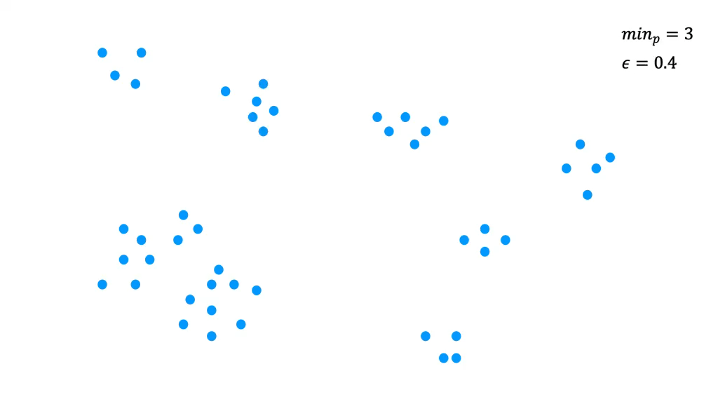
阶段性成果--Faiss on KG Subgraphs
Step2:子图划分
基于DBSCAN算法的层次聚类知识图谱子图划分算法
Notes:
However, directly applying Transformer to modeling stock movements is problematic in two aspects. Firstly, the global self-attention focuses on point-wise token similarities without contextual insights. So the lack of pattern-wise interaction hinders the adequate discrimination of stock tendency and is susceptible to noise points. Secondly, the basic query-key matching paradigm is position agnostic. For example, in this figure, {A;B} reflects stock wave patterns in the context of long-term spans and {C;D} reflects short-term spans. The patterns C and D are closer than A and B, which means that their interaction is more responsible for observing high-frequency regularities. This inspires us to factor in the elapsed time between stock change patterns.

Slide 20
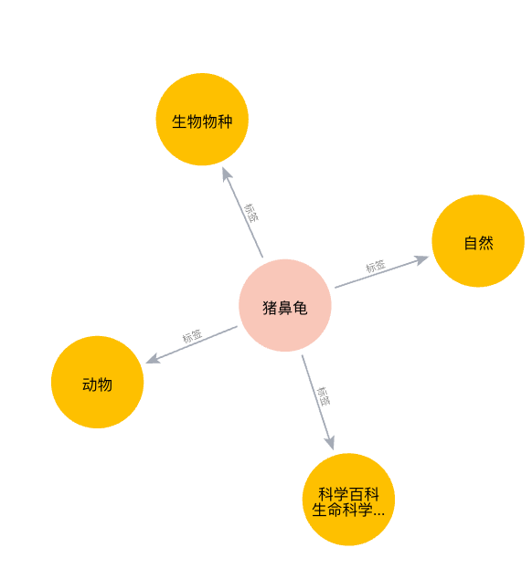
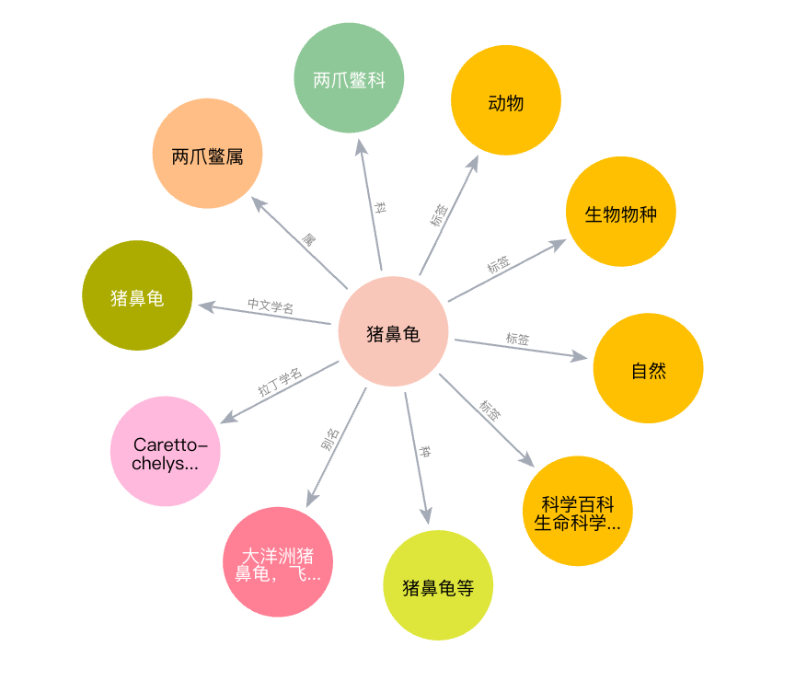
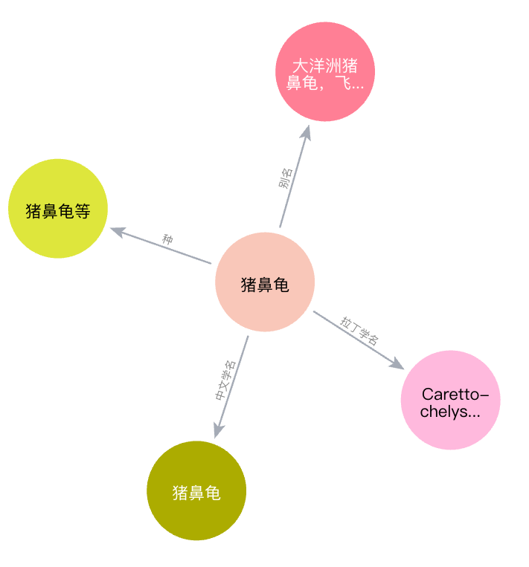
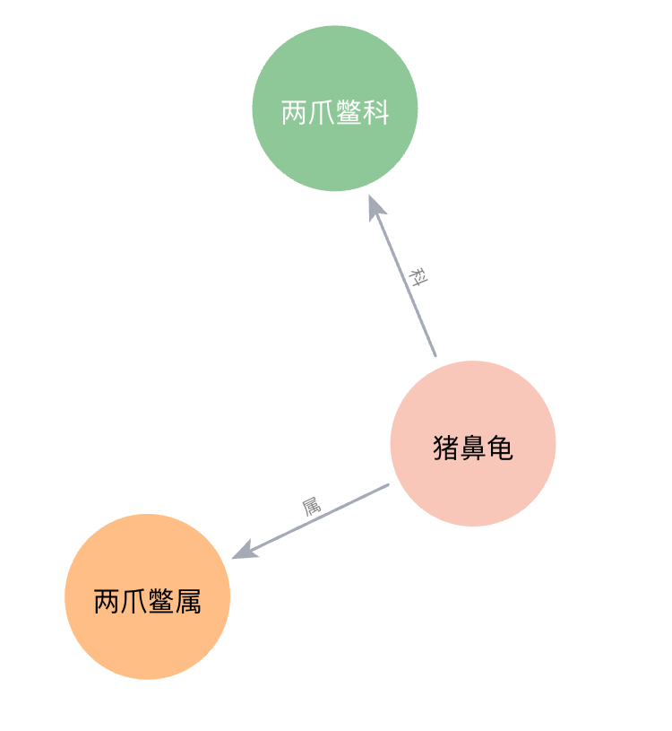
阶段性成果--Faiss on KG Subgraphs
Step3:基于知识图谱子图进行Faiss检索
1.将知识图谱子图进行嵌入
2.使用Faiss构建IndexFlatL2索引
3.将查询文本嵌入，将查询向量传递索引进行检索
4.将检索到的嵌入向量映射回原始知识图谱
Notes:
However, directly applying Transformer to modeling stock movements is problematic in two aspects. Firstly, the global self-attention focuses on point-wise token similarities without contextual insights. So the lack of pattern-wise interaction hinders the adequate discrimination of stock tendency and is susceptible to noise points. Secondly, the basic query-key matching paradigm is position agnostic. For example, in this figure, {A;B} reflects stock wave patterns in the context of long-term spans and {C;D} reflects short-term spans. The patterns C and D are closer than A and B, which means that their interaction is more responsible for observing high-frequency regularities. This inspires us to factor in the elapsed time between stock change patterns.

Slide 21
阶段性成果--领域基准测试
知识图谱与数据集构造
知识图谱
获取科学教育知识点名称5588个。
构造了一个包含100000条知识图谱三元组的科学教育知识图谱。
数据集
构造了包含50条与本文构建的科学教育知识图谱相关的自然问答对作为测试数据集。
Notes:
However, directly applying Transformer to modeling stock movements is problematic in two aspects. Firstly, the global self-attention focuses on point-wise token similarities without contextual insights. So the lack of pattern-wise interaction hinders the adequate discrimination of stock tendency and is susceptible to noise points. Secondly, the basic query-key matching paradigm is position agnostic. For example, in this figure, {A;B} reflects stock wave patterns in the context of long-term spans and {C;D} reflects short-term spans. The patterns C and D are closer than A and B, which means that their interaction is more responsible for observing high-frequency regularities. This inspires us to factor in the elapsed time between stock change patterns.

Slide 22
阶段性成果--领域基准测试
评价方法
选用忠实度(Faithfulness)、答案正确性(Answer Correctness)这两个评价指标。
忠实度
忠实度是用来衡量生成答案与检索得到的参考背景知识之间事实一致性的指标。
大模型生成答案包含的信息量有多少来自从检索捕获的信息量。
答案正确性
答案正确性涉及评估生成的答案与真实答案的准确性。答案正确性依赖于两个方面：生成答案的事实正确性和生成答案与真实答案之间的语义相似性。
Notes:
However, directly applying Transformer to modeling stock movements is problematic in two aspects. Firstly, the global self-attention focuses on point-wise token similarities without contextual insights. So the lack of pattern-wise interaction hinders the adequate discrimination of stock tendency and is susceptible to noise points. Secondly, the basic query-key matching paradigm is position agnostic. For example, in this figure, {A;B} reflects stock wave patterns in the context of long-term spans and {C;D} reflects short-term spans. The patterns C and D are closer than A and B, which means that their interaction is more responsible for observing high-frequency regularities. This inspires us to factor in the elapsed time between stock change patterns.

Slide 23
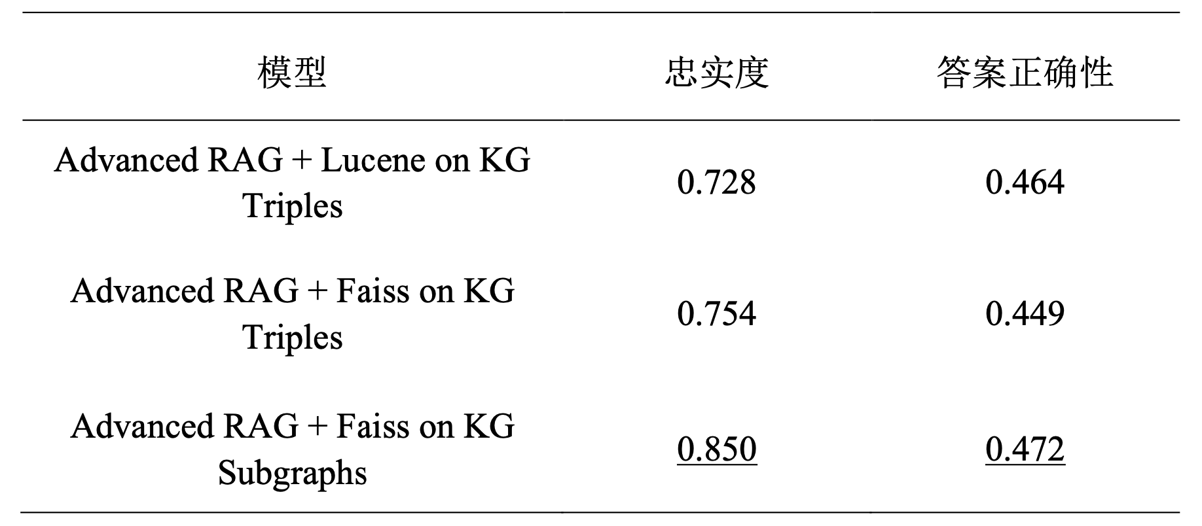
阶段性成果--领域基准测试
评价方法
实验一 以知识图谱子图作为检索单位的检索方法优越性对比
表5 实验一对照结果
Notes:
However, directly applying Transformer to modeling stock movements is problematic in two aspects. Firstly, the global self-attention focuses on point-wise token similarities without contextual insights. So the lack of pattern-wise interaction hinders the adequate discrimination of stock tendency and is susceptible to noise points. Secondly, the basic query-key matching paradigm is position agnostic. For example, in this figure, {A;B} reflects stock wave patterns in the context of long-term spans and {C;D} reflects short-term spans. The patterns C and D are closer than A and B, which means that their interaction is more responsible for observing high-frequency regularities. This inspires us to factor in the elapsed time between stock change patterns.

Slide 24
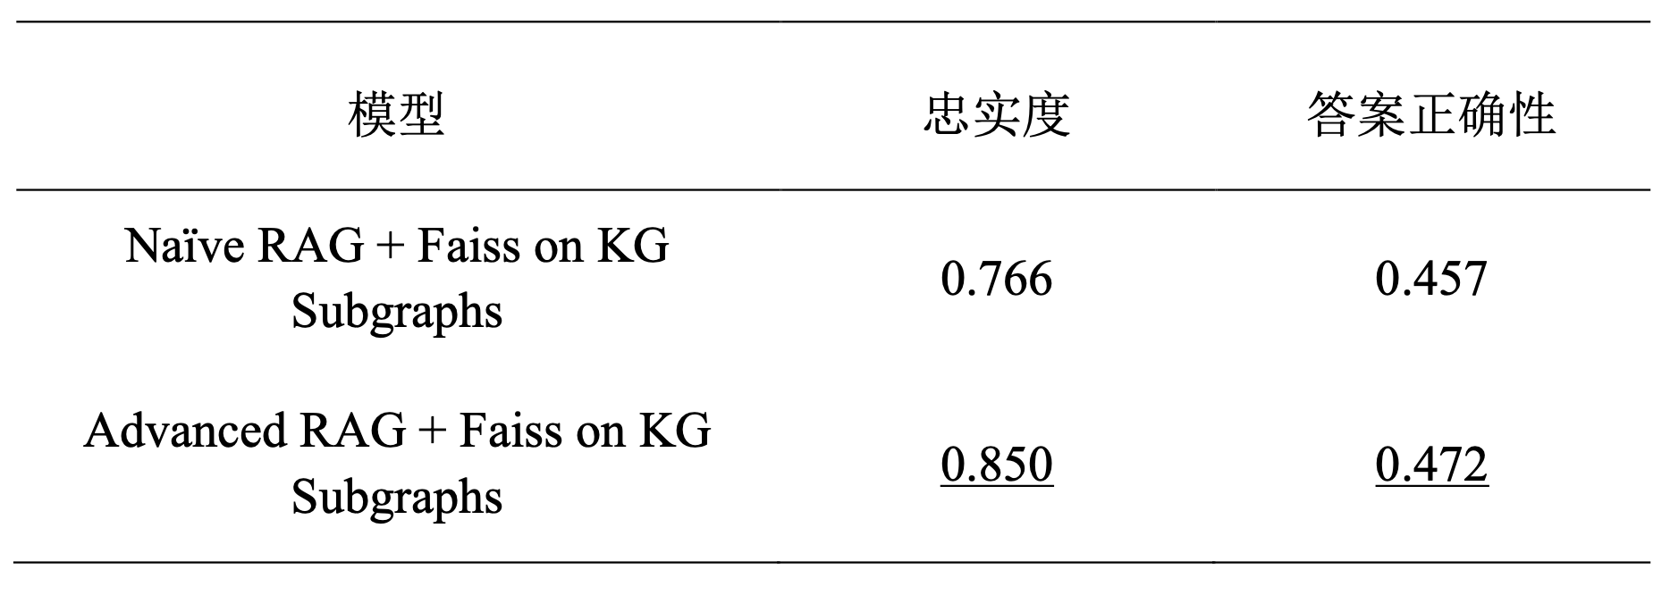
阶段性成果--领域基准测试
评价方法
实验二 优化检索增强生成框架优越性对比
表6 实验二对照结果
Notes:
However, directly applying Transformer to modeling stock movements is problematic in two aspects. Firstly, the global self-attention focuses on point-wise token similarities without contextual insights. So the lack of pattern-wise interaction hinders the adequate discrimination of stock tendency and is susceptible to noise points. Secondly, the basic query-key matching paradigm is position agnostic. For example, in this figure, {A;B} reflects stock wave patterns in the context of long-term spans and {C;D} reflects short-term spans. The patterns C and D are closer than A and B, which means that their interaction is more responsible for observing high-frequency regularities. This inspires us to factor in the elapsed time between stock change patterns.

Slide 25
阶段性成果—前端设计
1
Notes:
However, directly applying Transformer to modeling stock movements is problematic in two aspects. Firstly, the global self-attention focuses on point-wise token similarities without contextual insights. So the lack of pattern-wise interaction hinders the adequate discrimination of stock tendency and is susceptible to noise points. Secondly, the basic query-key matching paradigm is position agnostic. For example, in this figure, {A;B} reflects stock wave patterns in the context of long-term spans and {C;D} reflects short-term spans. The patterns C and D are closer than A and B, which means that their interaction is more responsible for observing high-frequency regularities. This inspires us to factor in the elapsed time between stock change patterns.

Slide 26
中期成果总结
总结
实现知识图谱可视化与动态交互。
提出了以知识图谱子图作为检索单位的的Faiss检索方法。基于DBSCAN算法的知识图谱子图划分作为嵌入检索单位。
实现原始检索增强生成框架的优化。在预检索处理，后检索处理方面对原始检索增强生成技术框架进行改进。使用结构化的知识图谱数据作为外部数据源来优化索引结构，设计了合理的提示来对用户提问进行重写。
使用RAGAs框架针对忠实性和答案正确性两个方向进行评估。在检索模块和检索增强生成框架两个方面设置了实验对照组，从而验证了论文中方法的有效性。
使用streamlit搭建系统界面
Notes:
However, directly applying Transformer to modeling stock movements is problematic in two aspects. Firstly, the global self-attention focuses on point-wise token similarities without contextual insights. So the lack of pattern-wise interaction hinders the adequate discrimination of stock tendency and is susceptible to noise points. Secondly, the basic query-key matching paradigm is position agnostic. For example, in this figure, {A;B} reflects stock wave patterns in the context of long-term spans and {C;D} reflects short-term spans. The patterns C and D are closer than A and B, which means that their interaction is more responsible for observing high-frequency regularities. This inspires us to factor in the elapsed time between stock change patterns.

Slide 27
下阶段计划
展望
进一步优化高级检索增强生成框架。对于现在的流水线结构，考虑将其修改为模块化的框架，能够递归的调用大模型自身的能力，例如加入让大模型反思，评估，输出的功能。
继续探索知识图谱检索。在知识图谱子图划分和嵌入的过程中，将知识图谱的结构信息和语义信息相结合加以利用。同时，在相似性检索的嵌入模块中加入微调嵌入的方法，使得检索到的内容与查询之间的相关性更加紧密。
Notes:
However, directly applying Transformer to modeling stock movements is problematic in two aspects. Firstly, the global self-attention focuses on point-wise token similarities without contextual insights. So the lack of pattern-wise interaction hinders the adequate discrimination of stock tendency and is susceptible to noise points. Secondly, the basic query-key matching paradigm is position agnostic. For example, in this figure, {A;B} reflects stock wave patterns in the context of long-term spans and {C;D} reflects short-term spans. The patterns C and D are closer than A and B, which means that their interaction is more responsible for observing high-frequency regularities. This inspires us to factor in the elapsed time between stock change patterns.

Slide 28
Thank you!
Notes:
That concludes my talk for today. Thank you!

